Slide 1
Sign Number and Addition, Subtraction

Slide 2
How To Represent Signed Numbers
Plus and minus sign used for decimal numbers: 25 (or +25), -16, etc.
For computers, desirable to represent everything as bits.
Three types of signed binary number representations:
signed magnitude,
1’s complement,
2’s complement.
In each case: left-most bit indicates sign: positive (0) or negative (1).

Slide 3
Signed Magnitude
Consider signed magnitude:
00001100₂ = 12₁₀
10001100₂ = -12₁₀
Sign bit
Magnitude
Sign bit
Magnitude

Slide 4
One’s Complement Representation
The one’s complement of a binary number involves inverting all bits.
1’s comp of 00110011 is 11001100
1’s comp of 10101010 is 01010101
To find negative of 1’s complement number take the 1’s complement.
00001100₂ = 12₁₀
11110011₂ = -12₁₀
Sign bit
Magnitude
Sign bit
Magnitude

Slide 5
One’s complement

Slide 6
Two’s Complement Representation
The two’s complement of a binary number involves inverting all bits and adding 1.
2’s comp of 00110011 is 11001101
2’s comp of 10101010 is 01010110
To find negative of 2’s complement number take the 2’s complement.
00001100₂ = 12₁₀
11110100₂ = -12₁₀
Sign bit
Magnitude
Sign bit
Magnitude

Slide 7
Two’s Complement Representation

Slide 8
Binary Addition
Binary addition is very simple.
This is best shown in an example of adding two binary numbers…
1
1
1
1
1
1
carries
1 1 1 1 0 1
+ 1 0 1 1 1
---------------------
1
0
1
0
1
0
0
Notes:
Design state of art organization in 1990

Slide 9
Binary Subtraction
We can also perform subtraction (with borrows in place of carries).
Let’s subtract (10111)₂ from (1001101)₂…
1 10
0 10 10 0 0 10
1 0 0 1 1 0 1
- 1 0 1 1 1
------------------------
1 1 0 1 1 0
borrows
Notes:
Design state of art organization in 1990

Slide 10
Binary Multiplication
Binary multiplication is much the same as decimal multiplication, except that the multiplication operations are much simpler…
1 0 1 1 1
X 1 0 1 0
-----------------------
0 0 0 0 0
1 0 1 1 1
0 0 0 0 0
1 0 1 1 1
-----------------------
1 1 1 0 0 1 1 0
Notes:
Design state of art organization in 1990

Slide 11
Addition
(123)₄ + (23)₄=(?)₄
(35)₅ + (23)₅=(?)₅

Slide 12
Addition using 1’s complement
(12)₁₀ + (23)₁₀=(?)₁₀

Slide 13
Addition using 2’s complement
(12)₁₀ + (23)₁₀=(?)₁₀

Slide 14
Subtraction using 1’s complement
Start
Find 1’s complement of both number
Add both number(1’s complement)
Is carry generated
Yes
Add carry into the sum
No
Result is ready
Take 1’s complement and Add negative sign

Slide 15
Subtraction using 1’s complement

Slide 16
Subtraction using 2’s complement
Start
Find 2’s complement of both number
Add both number(2’s complement)
Is carry generated
Yes
Discard the carry
No
Take 2’s complement and Add negative sign
Result is ready

Slide 17
Subtraction using 2’s complement

Slide 18
Binary Coded Decimal (BCD)
The BCD code is the 8,4,2,1 code.
8, 4, 2, and 1 are weights
BCD is a weighted code
This code is the simplest, most intuitive binary code for decimal digits and uses the same powers of 2 as a binary number, but only encodes the first ten values from 0 to 9.
Example: 1001 (9) = 1000 (8) + 0001 (1)
Notes:
Answer 1: 6
Answer 2: 1010, 1011, 1100, 1101, 1110, 1111

Slide 19
Think
How many “invalid” code words are there?
What are the “invalid” code words?

Slide 20
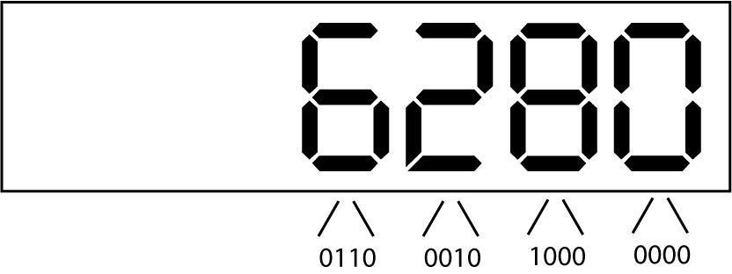
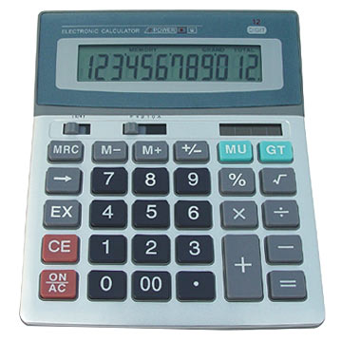
Uses of BCD
BCD enables fast conversions from denary to binary for applications such as pocket calculators.
Each digit on a calculator corresponds directly to a four-bit block in BCD.

Slide 21
Excess 3 Code and 8, 4, –2, –1 Code
Decimal | Excess 3 | 8, 4, –2, –1
0 | 0011 | 0000
1 | 0100 | 0111
2 | 0101 | 0110
3 | 0110 | 0101
4 | 0111 | 0100
5 | 1000 | 1011
6 | 1001 | 1010
7 | 1010 | 1001
8 | 1011 | 1000
9 | 1100 | 1111
What interesting property is common to these two codes?
Notes:
Answer: Both of these codes have the property that the codes for 0 and 9, 1 and 8, etc. can be obtained from each other by replacing the 0’s with the 1’s and vice-versa in the code words. Such a code is sometimes called a complement code.

Slide 22
Warning: Conversion or Coding?
Do NOT mix up conversion of a decimal number to a binary number with coding a decimal number with a BINARY CODE.
13₁₀ = 1101₂ (This is conversion)
13 ⇔ 0001|0011 (This is coding)

Slide 23
BCD Addition
Consider the following BCD operation
Decimal: Add 4 + 1
Covert to binary 0 1 0 0
And 0 0 0 1
Getting 0 1 0 1
Which is still a BCD representation of a decimal digit

Slide 24
Another
A second example
3 0 0 1 1
+3 0 0 1 1
Getting 6 or 0 1 1 0
And in range and a BCD digit representation

Slide 25
BCD Arithmetic
Given a BCD code, we use binary arithmetic to add the digits:
8
1000
Eight
+5
+0101
Plus 5
13
1101
is 13 (> 9)
Note that the result is MORE THAN 9, so must be represented by two digits!
To correct the digit, adding 6.
8
1000
Eight
+5
+0101
Plus 5
13
1101
is 13 (> 9)
+0110
so add 6
carry = 1
0011
leaving 3 + cy
0001 | 0011
Final answer (two digits)
If the digit sum is > 9, add one to the next significant digit

Slide 26
BCD Addition Example
Add 2905_{BCD} to 1897_{BCD} showing carries and digit corrections.
0
0001 1000 1001 0111
+ 0010 1001 0000 0101
Notes:
1 1 1 0
0001 1000 1001 0111
+ 0010 1001 0000 0101
0100 10010 1010 1100
+ 0000+ 0110+ 0110+ 0110
0100 1000 0000 0010

Slide 27
Number of Bits Required
Given M elements to be represented by a binary code, the minimum number of bits, n, needed, satisfies the following relationships:
2^{n} ≥ M > 2^{(n – 1)}
n = log₂ M
where x , called the ceiling function, is the integer greater than or equal to x.
Example: How many bits are required to represent decimal digits with a binary code?
Notes:
M = 10
Therefore n = 4 since:
2⁴ =16 is ≥ 10 > 2³ = 8
and the ceiling function for log₂ 10 is 4.

Slide 28
Number of Elements Represented
Given n digits in radix r, there are r^{n} distinct elements that can be represented.
But, you can represent m elements, m < r^{n}
Examples:
You can represent 4 elements in radix r = 2 with n = 2 digits: (00, 01, 10, 11).
You can represent 4 elements in radix r = 2 with n = 4 digits: (0001, 0010, 0100, 1000).
This second code is called a "one hot" code.

